Slide 1
Message Integrity and
Message Authentication
Dr. B C Dhara
Department of Information Technology
Jadavpur University

Slide 2
Objectives
Define message integrity & authentication
Define criteria for a cryptographic hash function
Define the Random Oracle Model and its role in
evaluating the security of cryptographic hash
functions
Distinguish between an MDC and a MAC
B C Dhara, Dept. of IT, JU

Slide 3
MESSAGE INTEGRITY
The cryptography systems that we have studied so far provide secrecy, or confidentiality, but not integrity
However, there are occasions where we may not even need secrecy but instead must have integrity
  Person ‘X’ write a will to distribute his property
    Need not to be encrypted, no change is allowed, i.e., integrity is important
B C Dhara, Dept. of IT, JU

Slide 4
Document and Fingerprint
One way to preserve the integrity of a document is through the use of a fingerprint
If Alice needs to be sure that the contents of her document will not be changed, she can put her fingerprint at the bottom of the document
B C Dhara, Dept. of IT, JU

Slide 5
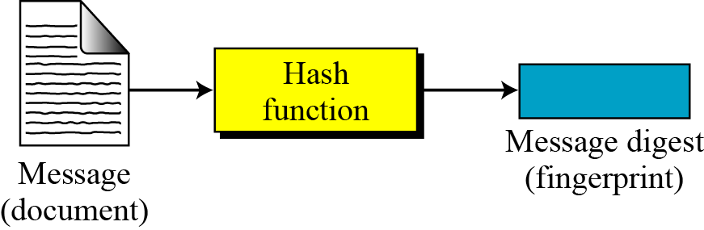
Message and Message Digest
The electronic equivalent of the document and fingerprint pair is the message and digest pair
  message will passes through a cryptographic hash function and creates a compressed message which is called as message digest
B C Dhara, Dept. of IT, JU

Slide 6
Difference: (message, digest) and (document, fingerprint)
The two pairs (document / fingerprint) and (message / message digest) are similar, with some differences
The document and fingerprint are physically linked together
The message and message digest can be unlinked and can sent separately
The message digest needs to be safe from change.
B C Dhara, Dept. of IT, JU

Slide 7

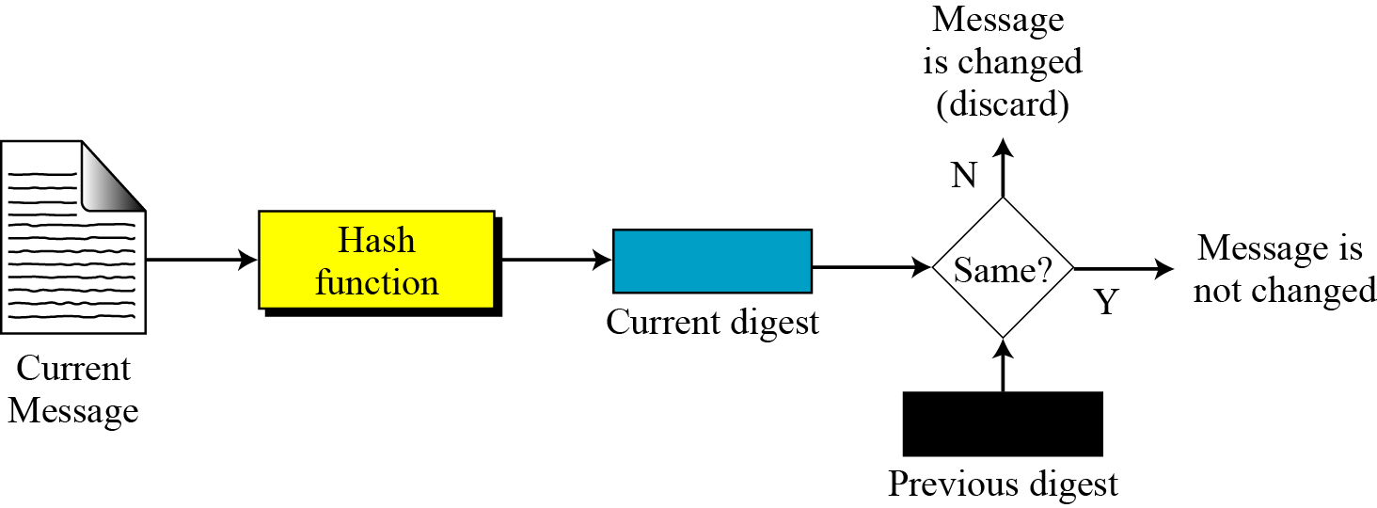
Checking Integrity
B C Dhara, Dept. of IT, JU

Slide 8
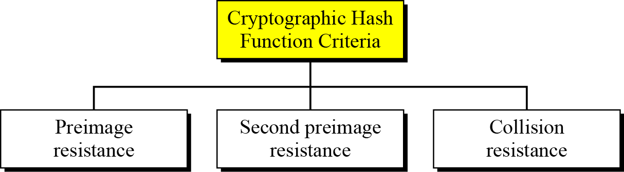
Cryptographic Hash Function Criteria
A cryptographic hash function must satisfy three criteria:
  preimage resistance,
  second preimage resistance, and
  collision resistance
B C Dhara, Dept. of IT, JU

Slide 9
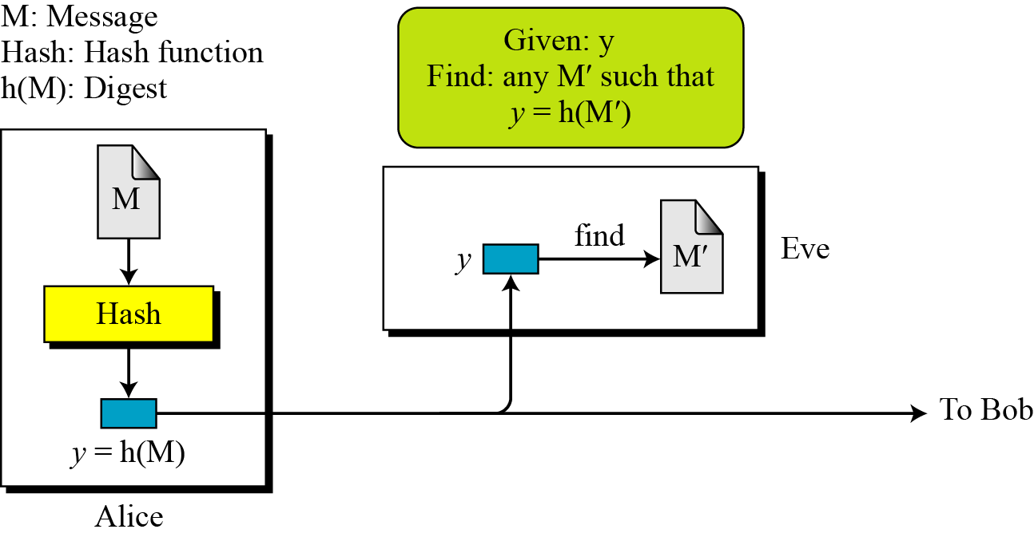
Preimage Resistance
B C Dhara, Dept. of IT, JU

Slide 10
Preimage Resistance (contd…)
Can we use a conventional lossless compression method such as StuffIt as a cryptographic hash function?
  No, since original message can be retrieved from compressed image by decoding technique
Can we use a checksum function as a cryptographic hash function?
  No, since many messages can be constructed for which we have same checksum value
B C Dhara, Dept. of IT, JU

Slide 11
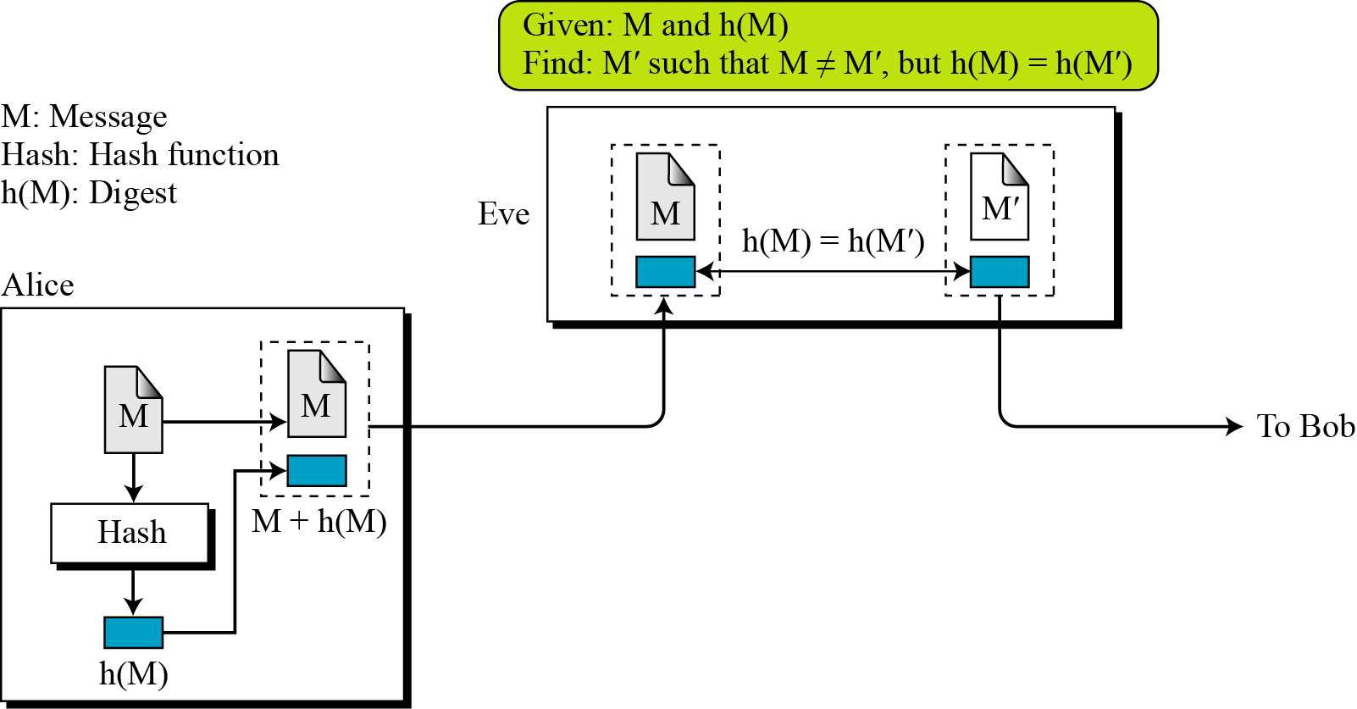
Second Preimage Resistance
Second preimage resistance ensures that a message cannot be forged easily
  Given a message and its digest, it is impossible (or very difficult) to create another message with same digest
B C Dhara, Dept. of IT, JU

Slide 12
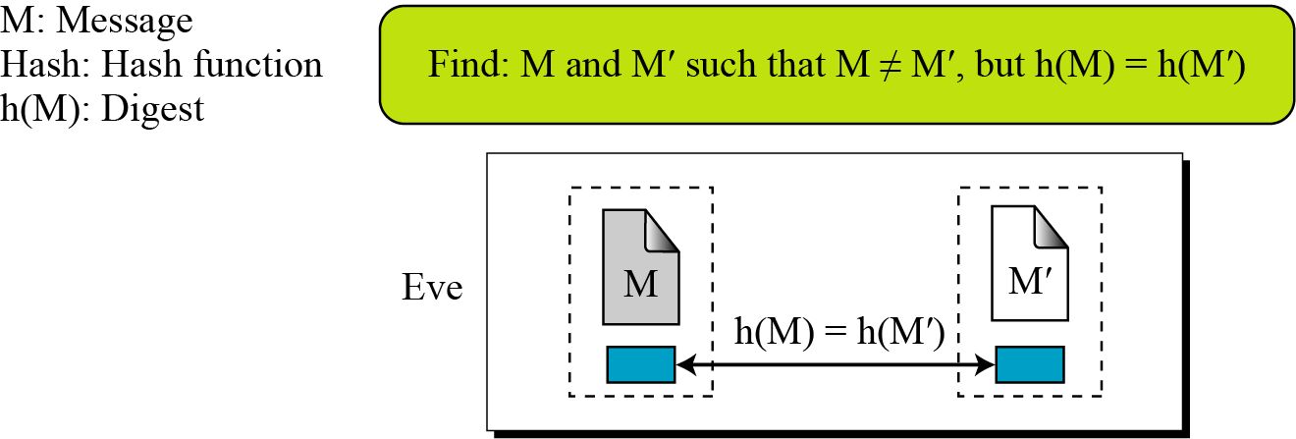
Collision Resistance
We cannot find two messages that hash to same digest
This attacker is easier than previous two attacks
B C Dhara, Dept. of IT, JU

Slide 13
RANDOM ORACLE MODEL
The Random Oracle Model is a mathematical model for a hash function
It behaves as
  For a new message of any length it creates a fixed length digest (which is random string of 0s and 1s)
    Also, records the (message, digest) pair
  For a message, checks it exists or not; if yes, simple return the digest
  Digest for a new message chosen independently from all previous digests
    i.e., no formula or algorithm is used to compute digest
B C Dhara, Dept. of IT, JU

Slide 14
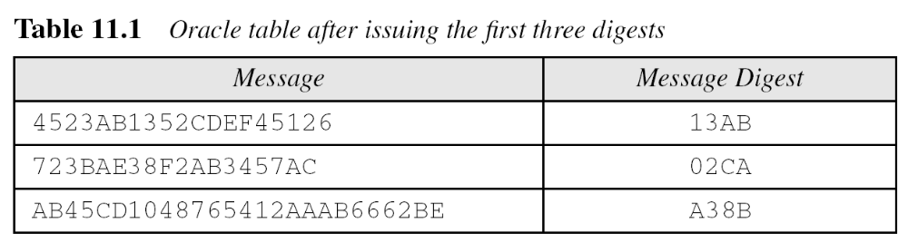
Example: RANDOM ORACLE MODEL
Assume an oracle with a table and a fair coin. The table has two columns
The message AB1234CD8765BDAD is given for digest calculation. The oracle checks its table
B C Dhara, Dept. of IT, JU

Slide 15
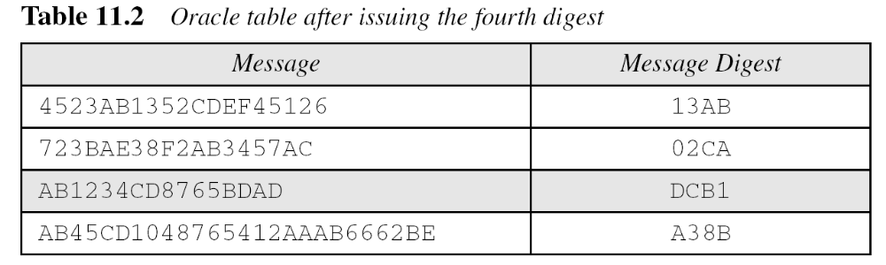
Example: RANDOM ORACLE MODEL (contd…)
b. The message 4523AB1352CDEF45126 is given for digest calculation. The oracle checks its table and finds that there is a digest for this message in the table (first row). The oracle simply gives the corresponding digest (13AB).
B C Dhara, Dept. of IT, JU

Slide 16
Example: RANDOM ORACLE MODEL (contd…)
The oracle cannot use a formula or algorithm to create the digest
For example, if formula h(M) = M mod n
Suppose oracle has h(M1) and h(M2)
If message is M3 = M1 + M2, then h(M3)= [h(M1) + h(M2)] mod n
This violates the third requirement that each digest must be randomly chosen based on the message given to the oracle.
B C Dhara, Dept. of IT, JU

Slide 17
Message-digest relation
Assume that the messages in a hash function are m bits long and the digests are only n (< m) bits long
Possible number of digests is 2^{n} = 16, and the Possible number of messages is 2^{m} = 64.
At least one digest corresponds to 2^{m-n} messages
B C Dhara, Dept. of IT, JU

Slide 18
Birthday problems
To analyze the Random Oracle Model, result of birthday problems are important
P1: what is the minimum number, k, of students in a classroom such that it is likely that at least one student has a predefined birthday with probability ≥ ½ ?
  Let N possible birthdays
  No one has predefined birthday, probability is (1-1/N)^{k}
  at least one has predefined birthday, probability is 1- (1-1/N)^{k}
1-x ≈ e^{-x}, for small x
1- (1-1/N)^{k} ≥ ½
(1-1/N)^{k} ≤ ½
e^{-k/N} ≤ ½
e^{k/N}≥2
k ≥ ln 2 *N
B C Dhara, Dept. of IT, JU

Slide 19
Birthday problems (contd…)
P2: what is the minimum number, k, of students in a classroom such that at least one student has same birthday as the student selected by the teacher with probability ≥ ½ ?
Like previous one,
First student is selected by the professor and then there are k-1 students to full fill the selected value.
Hence, probability is P= 1- (1-1/N)^{k-1}
Therefore, k ≥ ln 2 *N+1
B C Dhara, Dept. of IT, JU

Slide 20
Birthday problems (contd…)
P3: what is the minimum number, k, of students in a classroom such that it likely that at least two students have same birthday with probability ≥ ½ ?
It can be easily proved that probability P= 1-e^{-k2/2N} and k ≥ (2 * ln 2)^{1/2} * N^{1/2}
B C Dhara, Dept. of IT, JU

Slide 21
Birthday problems (contd…)
P4: we have two classes, each with k students. What is the minimum value of k such that it likely that at least one student from first class has same birthday as one student from second class with probability ≥ ½ ?
It can be easily proved that probability P= 1-e^{-k2/N} and k ≥ (ln 2)^{1/2} * N^{1/2}
B C Dhara, Dept. of IT, JU

Slide 22
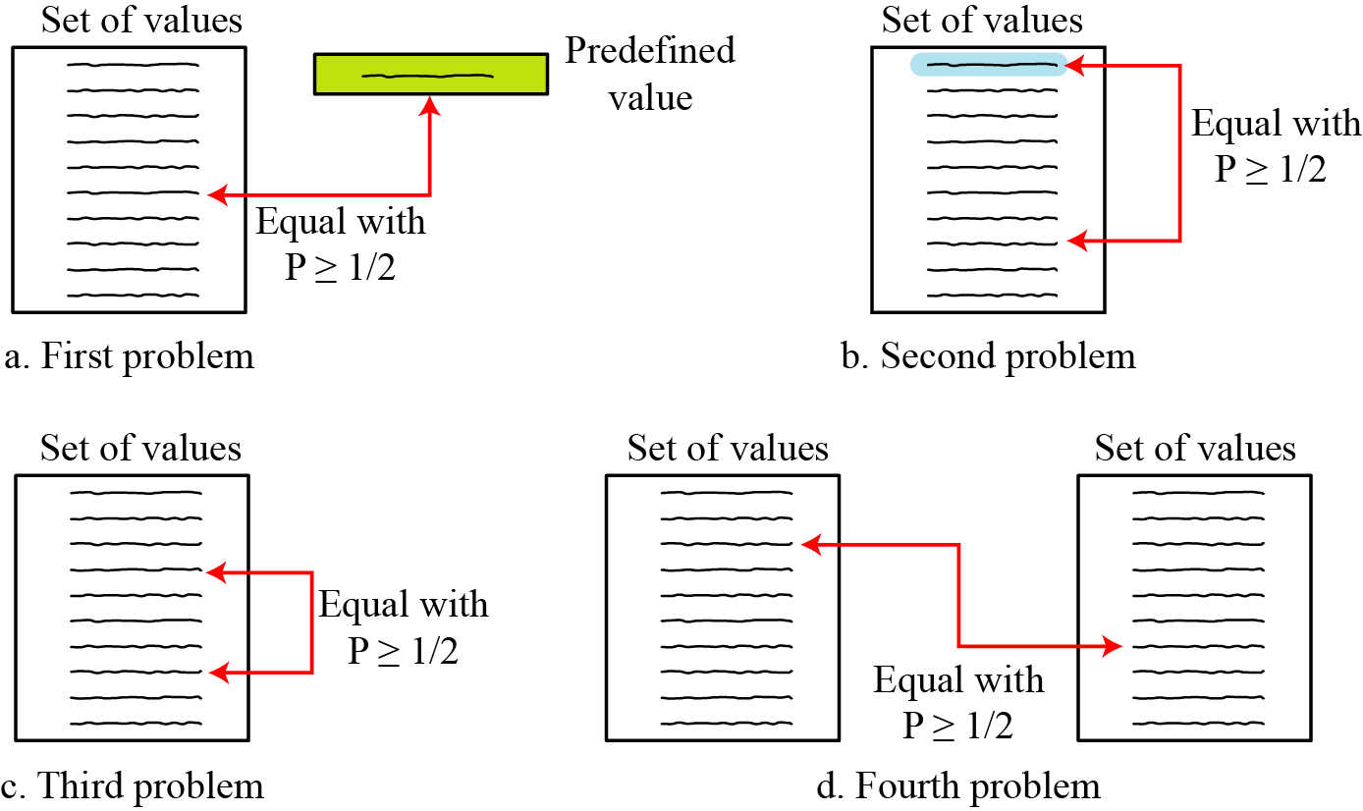
Birthday problems (contd…)
B C Dhara, Dept. of IT, JU

Slide 23
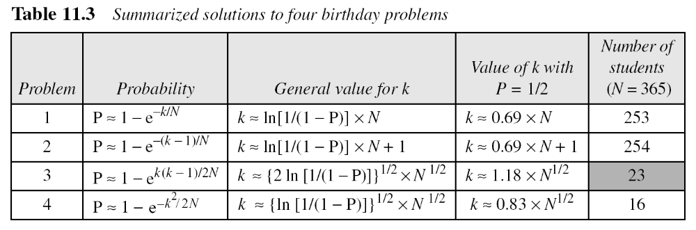
Summary of Solutions
The third problem is known as birthday paradox
The result shows that is there are just 23 students in a classroom, it is likely (with P ≥ ½) that two students have same birthday (ignoring year of birth)
B C Dhara, Dept. of IT, JU

Slide 24
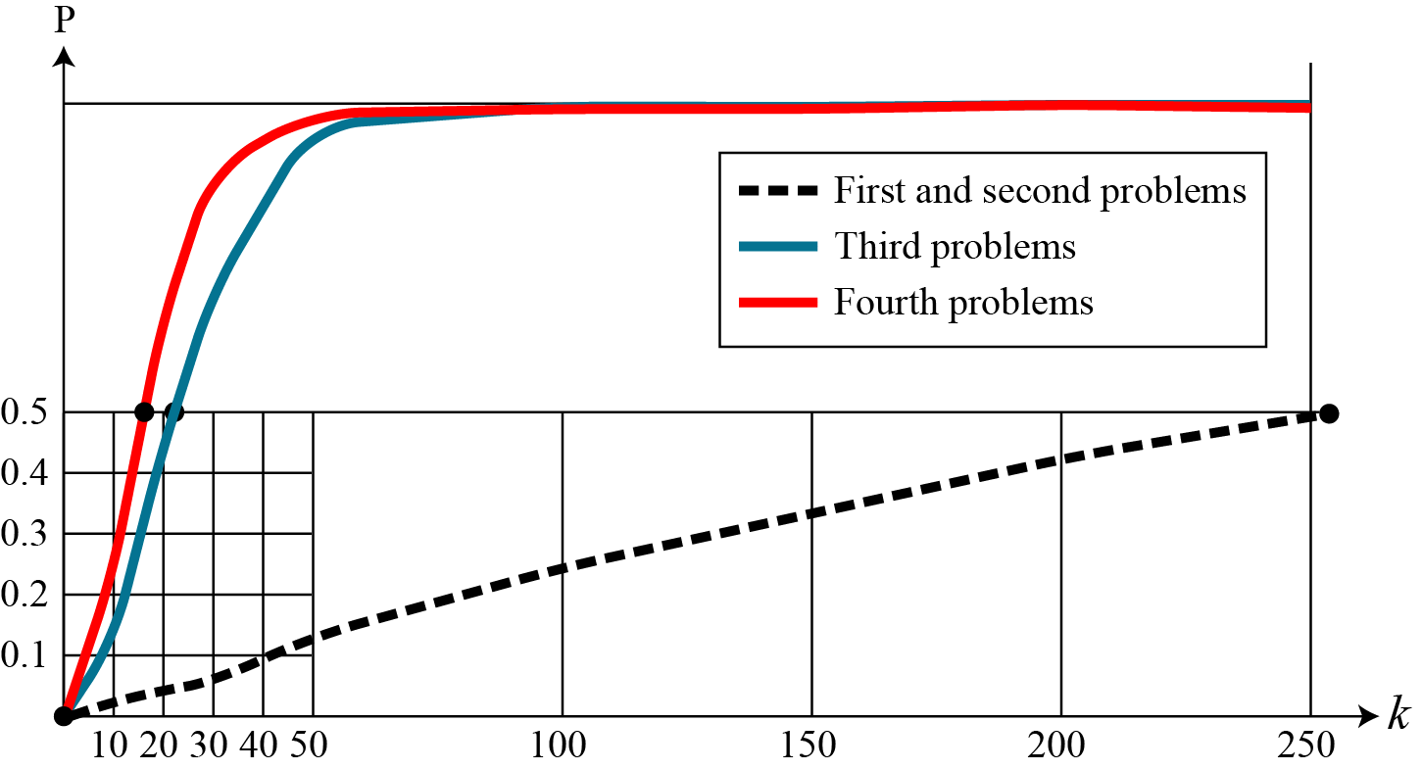
Discussion on birthday problems
It can be shown that first problem is related to the preimage attacks
Second problem is related to the second preimage attacks
Third and fourth problems are related to the collision attacks
It is obtained that value of k in first and second problems are proportional to N
In third and fourth problems it is proportional to N^{1/2}
It is much more difficult to lunch preimage attack and second preimage attack compare to the collision attack
B C Dhara, Dept. of IT, JU

Slide 25
Attacks on Random Oracle Model
Random Oracle model creates n bit digests
The oracle selects one value ∈ [0 2^{n}-1] randomly for the given message
  Does not imply that selection is exhaustive, i.e., some values may never be selected whereas some other values are selected several times
Hash function is public and value of n also public
B C Dhara, Dept. of IT, JU

Slide 26
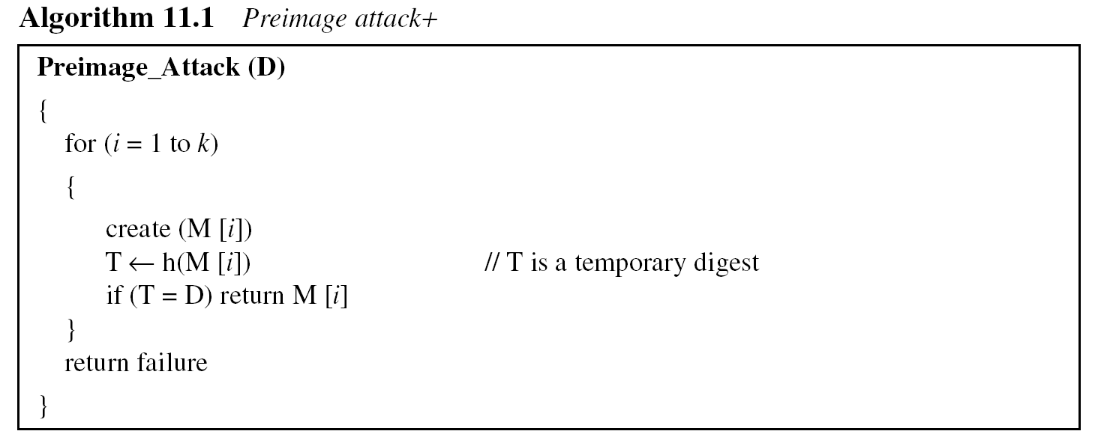
Preimage attack
In preimage attack
  An adversary intercepts a digest ‘D’ and try to find any message M1 such that h(M1)=D
// consider a list of k messages
// the probability to be at least 50 percent successful,
// k should be k ≈ 0.69*N i.e., ≈ 0.69*2^{n}
B C Dhara, Dept. of IT, JU

Slide 27
Preimage attack (contd…)
A cryptographic hash function uses a digest of 64 bits. How many digests does Eve need to create to find the original message with the probability more than 0.5?
Solution
The number of digests to be created is k ≈ 0.69 × 2^{n} ≈ 0.69 × 2⁶⁴. This is a large number. Even if Eve can create 2³⁰ (almost one billion) messages per second, it takes 0.69 × 2³⁴ seconds or more than 500 years. This means that a message digest of size 64 bits is secure with respect to preimage attack, but, as we will see shortly, is not secured to collision attack.
B C Dhara, Dept. of IT, JU

Slide 28
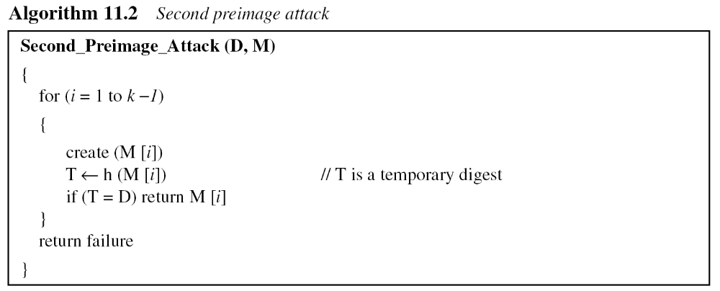
Second preimage attack
Intercepts digest ‘D’ with corresponding message M, i.e. D=h(M) and try to find another message M1 so that D=h(M1)
// consider a list of k-1 messages
// the probability to be at least 50 percent successful,
// k should be k ≈ 0.69*N+1 i.e., ≈ 0.69*2^{n} +1
B C Dhara, Dept. of IT, JU

Slide 29
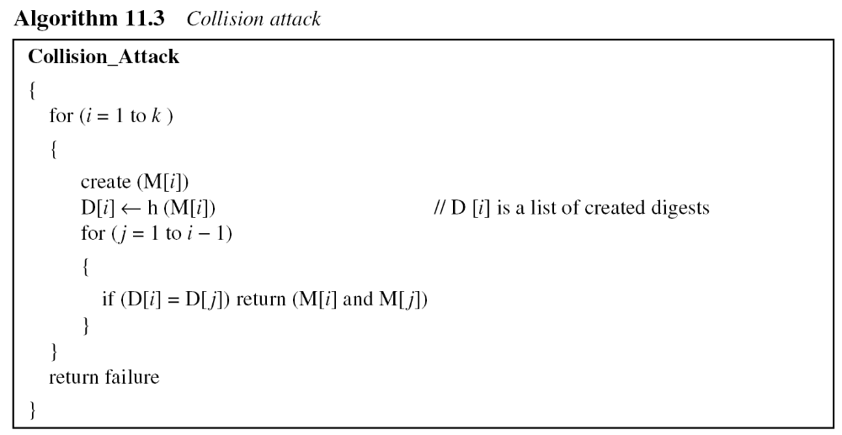
Collision Attack
Adversary needs to find two messages M1 and M2 such that h(M)=h(M1)
// consider a list of k messages
// the probability to be at least 50 percent successful,
// k should be k ≈ 1.18*N^{½} i.e., ≈ 1.18*2^{n/2}
B C Dhara, Dept. of IT, JU

Slide 30
Collision Attack (contd…)
A cryptographic hash function uses a digest of 64 bits. How many digests does Eve need to create to find two messages with the same digest with the probability more than 0.5?
Solution
The number of digests to be created is k ≈ 1.18 × 2^{n/2} ≈ 1.18 × 2³². If Eve can test 2²⁰ (almost one million) messages per second, it takes 1.18 × 2¹² seconds, or less than two hours. This means that a message digest of size 64 bits is not secure against the collision attack.
B C Dhara, Dept. of IT, JU

Slide 31
Alternate Collision Attack
In this attack, an adversary needs to create two messages: one real and other one is bogus such that they have same digest
Attacker considered two original messages M and M’ and then these messages are modified without changing the meaning
From the messages: k different variants are generated
  M: M₁, M₂, …, M_{k} and M’: M’₁, M’₂, …, M’_{k}
B C Dhara, Dept. of IT, JU

Slide 32
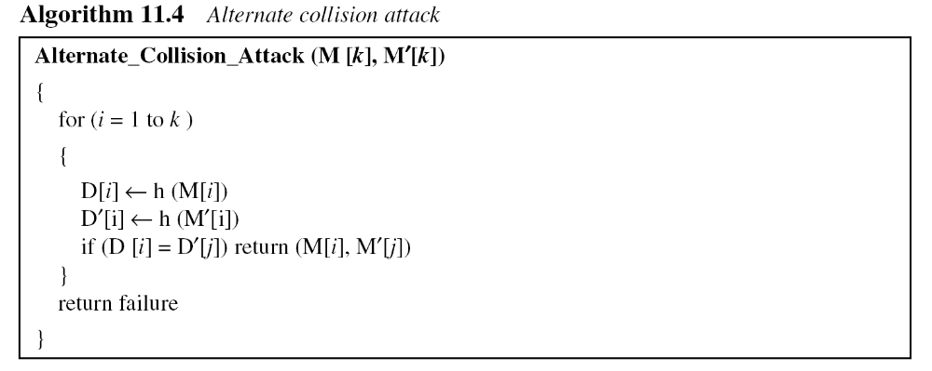
Alternate Collision Attack (contd…)
// the probability to be at least 50 percent successful,
// k should be k ≈ 0.83*N^{½} i.e., ≈ 0.83*2^{n/2}
B C Dhara, Dept. of IT, JU

Slide 33
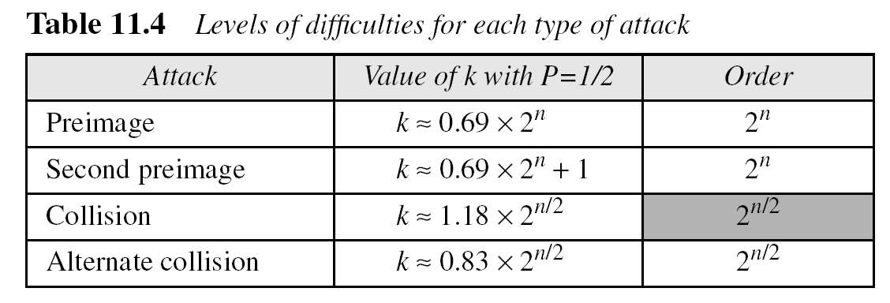
Summary of Attacks
Level of difficulty for collision attack is much less than preimage and second preimage attacks
if hash algorithm is collision resistance, no worry about the first two attacks
B C Dhara, Dept. of IT, JU

Slide 34
Example
Originally hash functions with a 64-bit digest were believed to be immune to collision attacks
But with the increase in the processing speed, today everyone agrees that these hash functions are no longer secure
Eve needs only 2^{64/2} = 2³² tests to launch an attack with probability 1/2 or more
Assume she can perform 2²⁰ (one million) tests per second. She can launch an attack in 2³²/2²⁰ = 2¹² seconds (almost an hour).
B C Dhara, Dept. of IT, JU

Slide 35
Example
MD5 (see Chapter 12), which was one of the standard hash functions for a long time, creates digests of 128 bits
To launch a collision attack, the adversary needs to test 2⁶⁴ (2¹²⁸/2) tests in the collision algorithm
Even if the adversary can perform 2³⁰ (more than one billion) tests in a second, it takes 2³⁴ seconds (more than 500 years) to launch an attack
This type of attack is based on the Random Oracle Model. It has been proved that MD5 can be attacked on less than 2⁶⁴ tests because of the structure of the algorithm
B C Dhara, Dept. of IT, JU

Slide 36
Example
SHA-1 (see Chapter 12), a standard hash function developed by NIST, creates digests of 160 bits
To launch a collision attack, the adversary needs to test 2^{160/2} = 2⁸⁰ tests in the collision algorithm
Even if the adversary can perform 2³⁰ (more than one billion) tests in a second, it takes 2⁵⁰ seconds (more than ten thousand years) to launch an attack
However, researchers have discovered some features of the function that allow it to be attacked in less time than calculated above
B C Dhara, Dept. of IT, JU

Slide 37
Example
The new hash function, that is likely to become NIST standard, is SHA-512 (see Chapter 12), which has a 512-bit digest
This function is definitely resistant to collision attacks based on the Random Oracle Model. It needs 2^{512/2} = 2²⁵⁶ tests to find a collision with the probability of 1/2.
B C Dhara, Dept. of IT, JU

Slide 38
Attacks on the Structure
The adversary may have other tools to attack hash function. One of these tools, for example, is the meet-in-the-middle attack that we discussed for double DES
B C Dhara, Dept. of IT, JU

Slide 39
MESSAGE AUTHENTICATION
The digest created by a cryptographic hash does not authenticate the sender of the message
To provide message authentication, Alice needs to provide proof that it is Alice sending the message and not an impostor
Digest is normally called a modification detection code (MDC)
What we need for message authentication is a message authentication code (MAC).
B C Dhara, Dept. of IT, JU

Slide 40
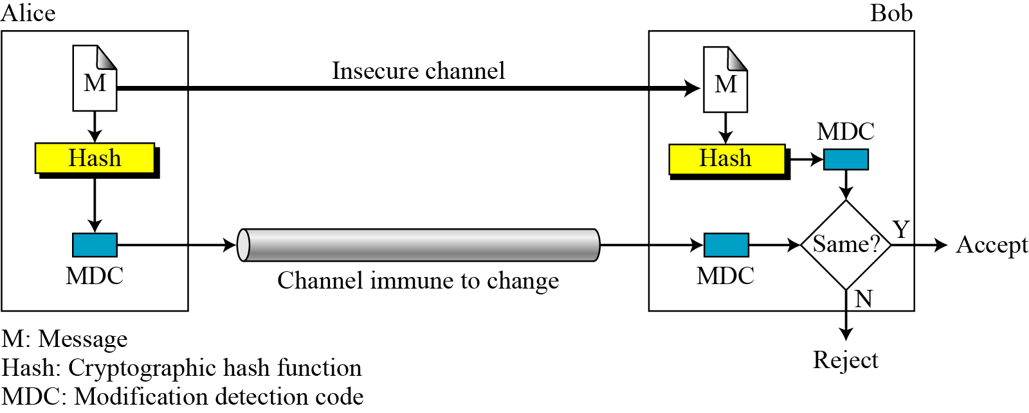
Modification Detection Code (MDC)
A modification detection code (MDC) is a message digest that can prove the integrity of the message: that message has not been changed
If Alice needs to send a message to Bob and be sure that the message will not change during transmission, Alice can create a message digest, MDC, and send both the message and the MDC to Bob
Bob can create a new MDC from the message and compare the received MDC and the new MDC. If they are the same, the message has not been changed
Example of will
B C Dhara, Dept. of IT, JU

Slide 41
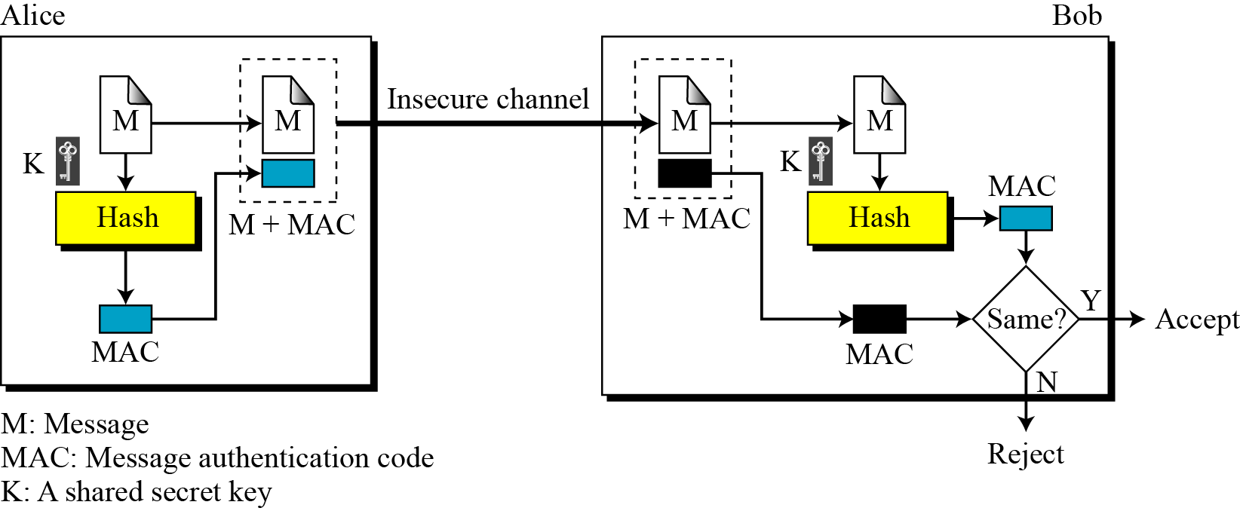
Message authentication code
To ensure the integrity and origin authentication of a message, we need to change the modification detection code (MDC) to message authentication code (MAC)
h(K || M)
B C Dhara, Dept. of IT, JU

Slide 42
Message authentication code (contd…)
Both the message and digest can send through an insecure channel
Attacker can see this, but cannot forge a new message to replace it since attacker does not have the secret key
Still MAC is insecure
B C Dhara, Dept. of IT, JU

Slide 43
Security of MAC
Attacker can intercepted M and h(K | M)
If key size allows exhaustive search, then key can be identified and hence a new forged message can be used
Given some pairs of message and MAC, attacker can manipulate to come up with a new message and its MAC
The security of a MAC depends on the security of the underlying hash algorithm.
B C Dhara, Dept. of IT, JU

Slide 44
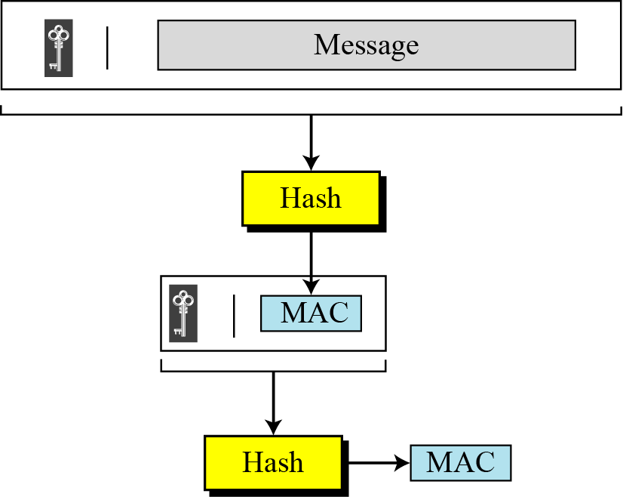
Nested MAC
To improve the security, Nested MAC is designed
B C Dhara, Dept. of IT, JU

Slide 45
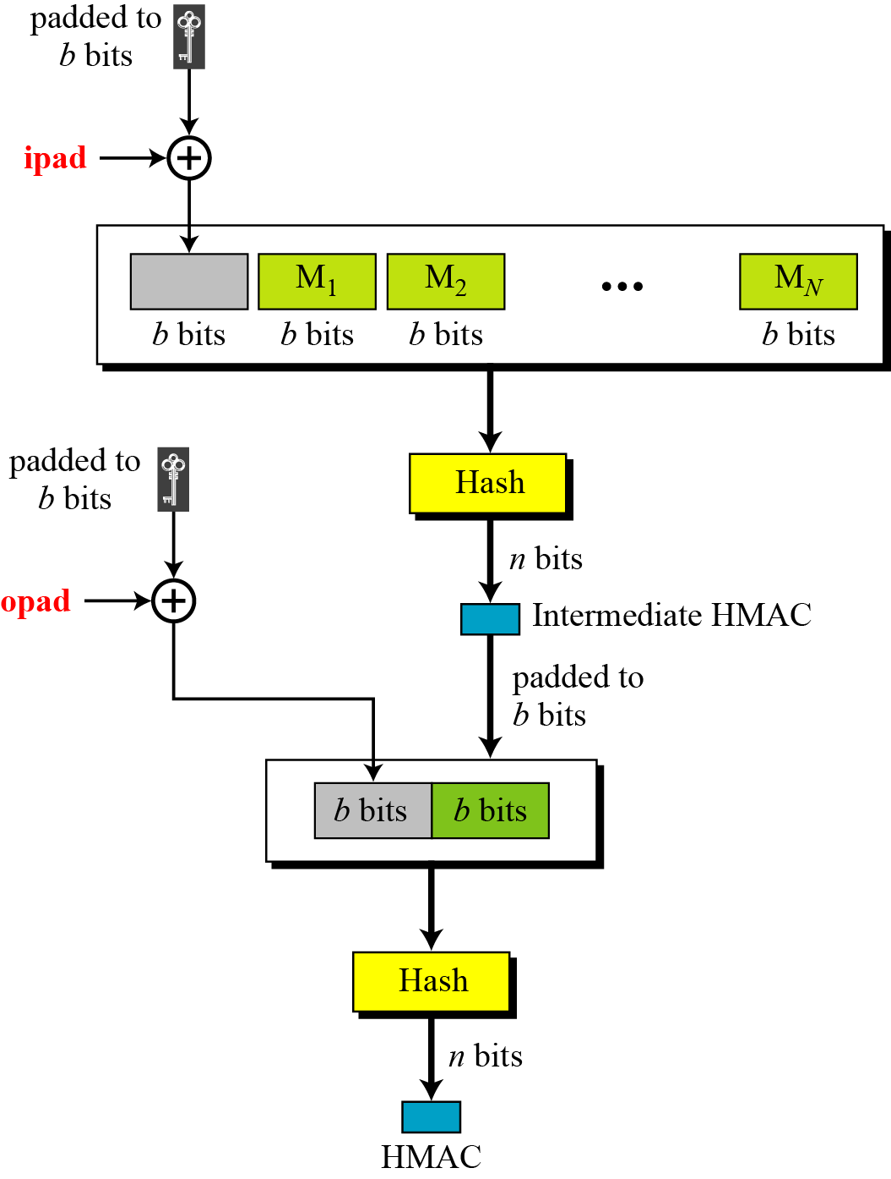
Hashed MAC (HMAC)
Design of HMAC more complex than nested MAC
The message is divided into N blocks, each b bits
Secret key is left padded with 0’s to create a b-bit key
Modified key is XOR-ed with a constant ‘ipad’
The resulting block is prepended to the N blocks and results N+1 blocks
n-bits digest, called intermediate HMAC, is computed for above data
B C Dhara, Dept. of IT, JU

Slide 46
Hashed MAC (HMAC) (contd…)
Secret key is left padded with 0’s to create a b-bit key
Modified key is XOR-ed with a constant ‘opad’
The result is prepended to intermediate HMAC
Again, compute hash value, which is final digest
B C Dhara, Dept. of IT, JU

Slide 47
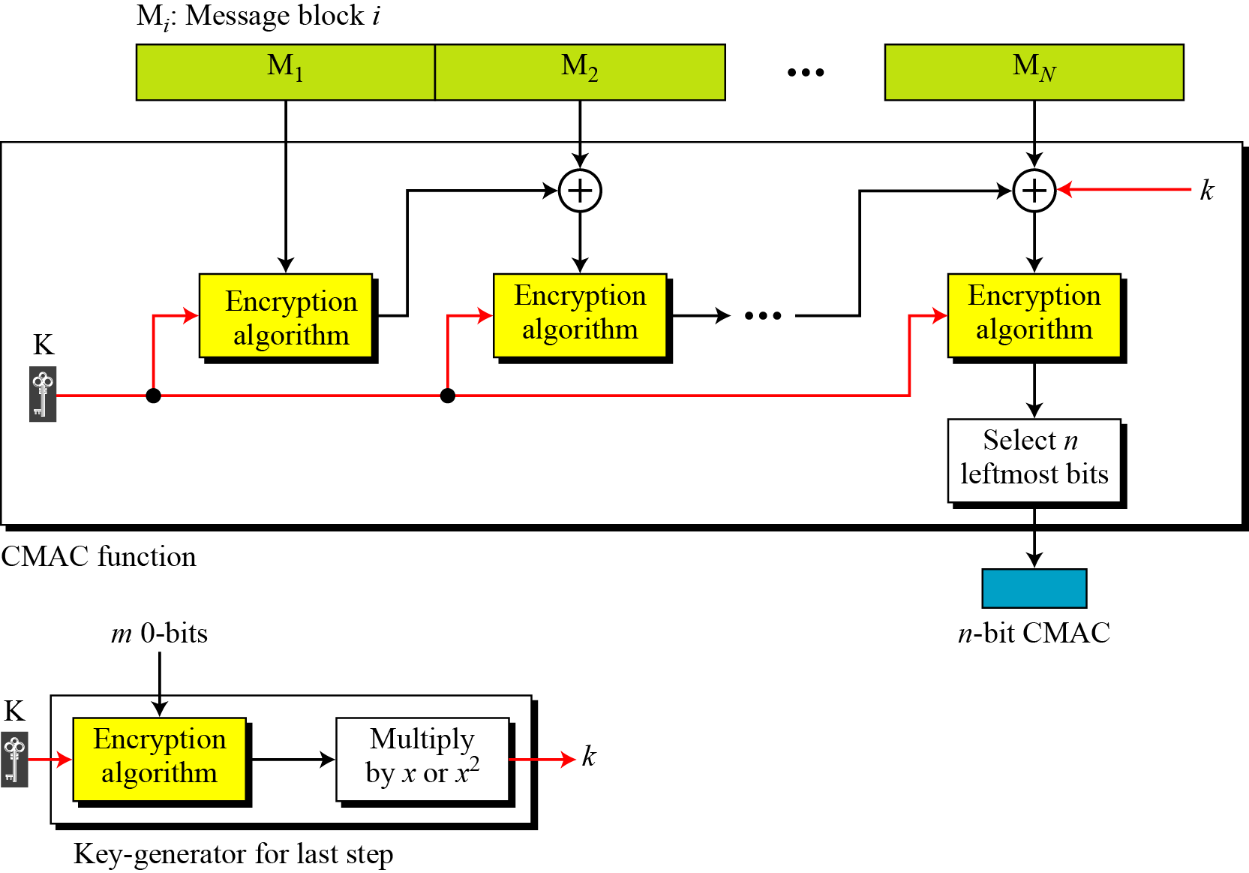
Cipher based MAC (CMAC)
B C Dhara, Dept. of IT, JU

